Slide 1
2
E-commerce
Haseeb zahid 2020-CS-20
Hassan nisar 2020-CS-49
Atta ul mohamin 2020-CS-43
www.yourwebsite.com

Slide 2
2
Glance&co.
TABLE OF CONTENT
Categoty,purpose, scope
FUNCTIONAL
REQUIREMENTS
TEAM WORK
COMPLETENESS
GOAL

Slide 3

Purpose & scope
The purpose of developing the “e-commerce” is to sell and purchase the projects
Software engineering
SCOPE:
It will integrates the benefits for a physical market and also for a common person

Slide 4
FUNCTIONAL REQUIREMENTS
2
SIGN UP
UPDATE
FUNCIONAL
REQUIREMENTS
SIGN IN
DELETE
ADD
SEARCH
www.yourwebsite.com

Slide 5
Setting UP Goal
05
04
03
02
Perform operation and testing
01
ROUTING
API integration
Html & css
Creating angular app
www.yourwebsite.com

Slide 6
Team Work
2
ATTA UL
MOHAMIN
HASEEB ZAHID
HASSAN NISAR
Make headerz
Seller Sign Up Page
Routing setup , JSON SERVER
Seller sign Up API
Auth Guard , Seller Login API
Seller Login Form
Update NaveBar Menu
Logout and Routing
Add Product Form
Delete Product
Product List With API, Font Awesome icons
Add Product API integration,Update Product UI
Login From Validation
Add To Cart without login
Remove To cart, Add To Cart with User login
Get Cart Item
Remove To Cart , Cart Page
Local Storage Cart To DB
Cart Detail
Order
My Order Screen
Cart Detail
My Order List
Cancel Order
Bootstrap and Carousel
Update Prduct API,Display Product in carousel
Populate Update Product Data
Product List in Home Page
Search Page UI, Product List in Home Page
Product List in Home Page
Sign Up
Links To Details Page
Search API , Product Detail Page
Sign Up API
Sign Up Header Update
User Login UI, Login API

Slide 7
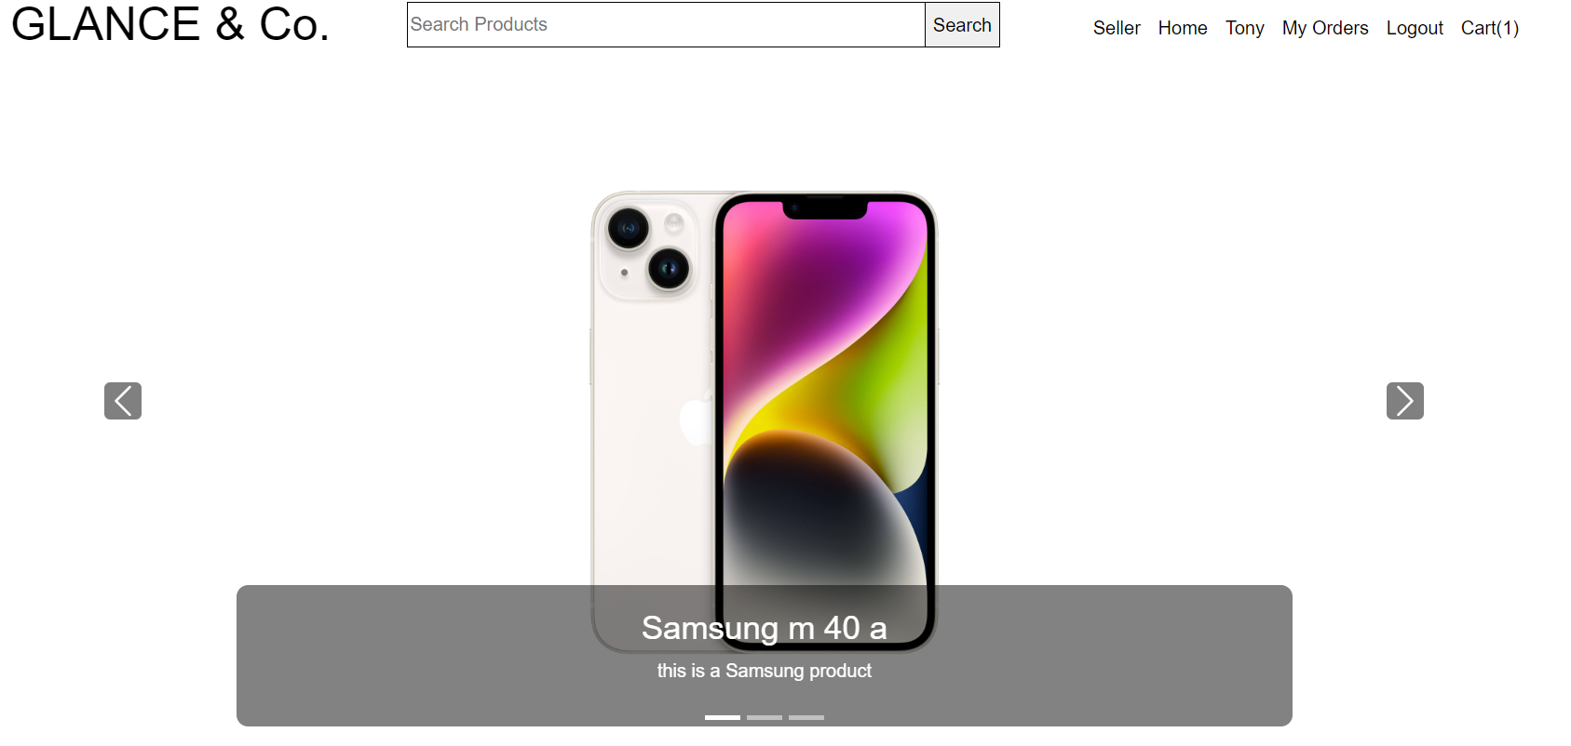
2
Main page
1
Home
YOUR IMAGE
2
User
3
CART
4
Seller
www.yourwebsite.com

Slide 8
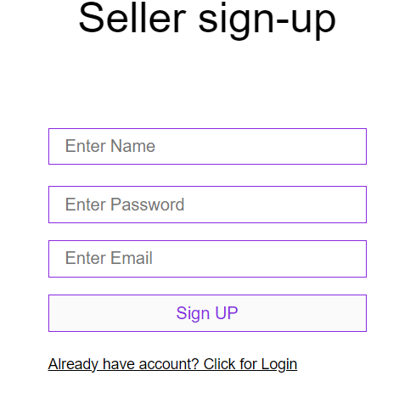
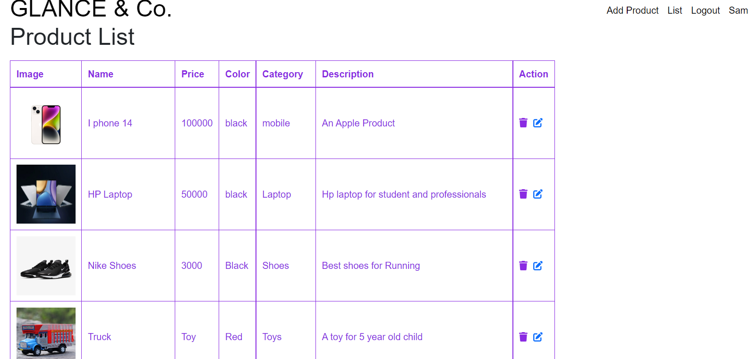
2
Seller page
1
SIGN UP: first seller signup
2
Seller inventory
www.glance&co..com

Slide 9
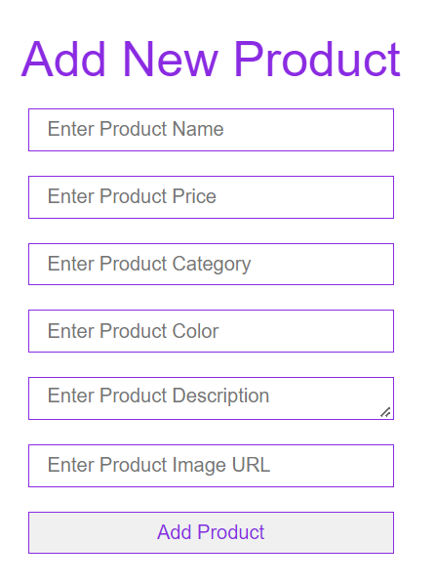
2
Crud operation
1
Add products
2
Update
3
Delete
www.glance&co..com

Slide 10
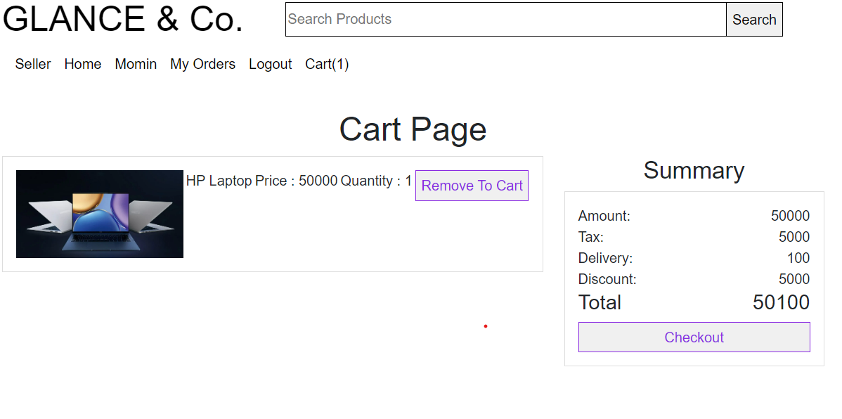
2
Cart page
1
Cart page
www.glance&co..com

Slide 11
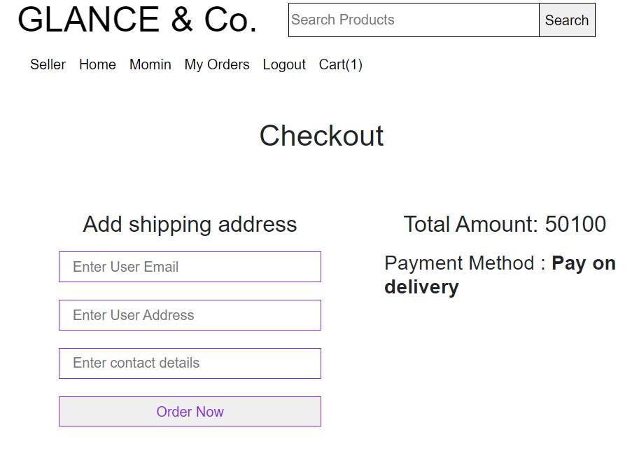
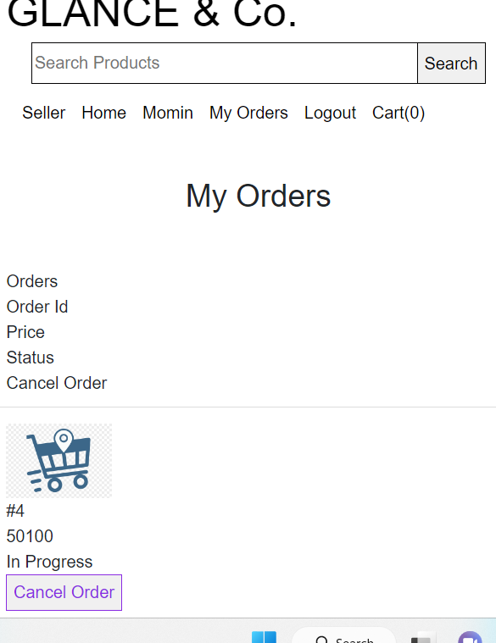
2
Shipment
1
Placing order
www.glance&co..com

Slide 12
Milestones
2
04
Testing
03
Software development
02
Collect requirement.
Software design
01
www.yourwebsite.com

Slide 13
COMPLETENESS
2
SELLER
We can add product and signIn/signUp using it
BUYER
We can purchase product and signIn/SignUp.
CRUD OPERATIONS
We can perfrom delete and update operations
www.yourwebsite.com

Slide 14
Tools and DEPLOYMENT:
used
2
Database Server : web server
Client : Microsoft Internet Explorer or any web browser
DevelopmentTools : Microsoft Visual Studio 2013
Programming Language : jawa script
Operating System Server: Windows,Linux,UNIX
www.yourwebsite.com

Slide 15
User stories
2
01
User first signup and then login
02
User can see the products and buy anything to put in cart
03
Now user can checkout and give shipment info and can cance order
www.yourwebsite.com

Slide 16
THANK YOU

